Slide 1
The EM algorithm
Tine

Slide 2
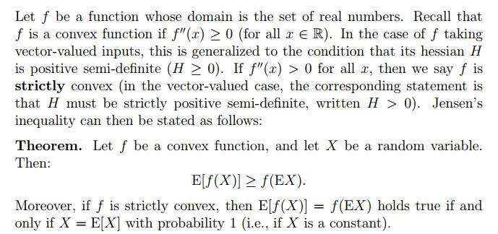
Jensen’s inequality

Slide 3
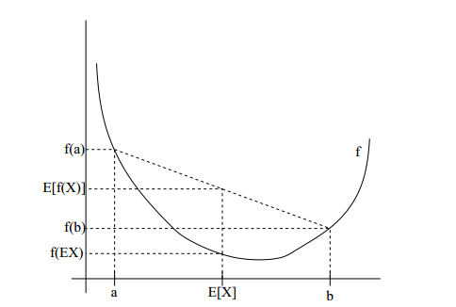
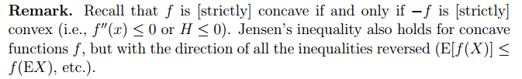

Slide 4
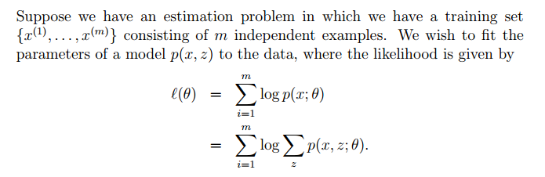
The EM algorithm

Slide 5
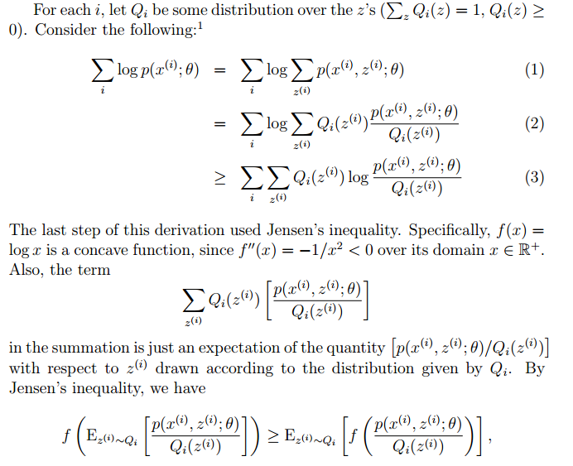

Slide 6
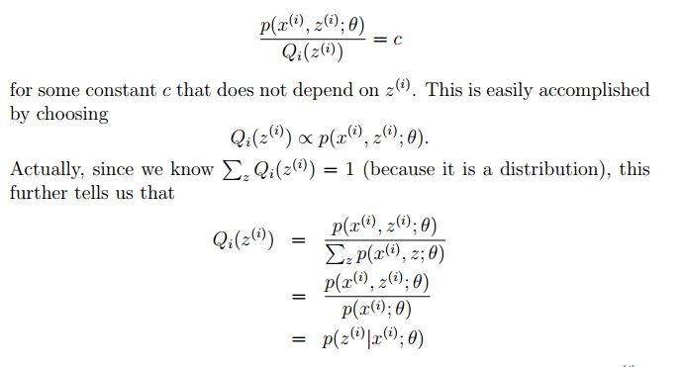

Slide 7
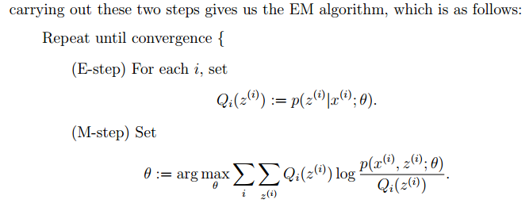

Slide 8
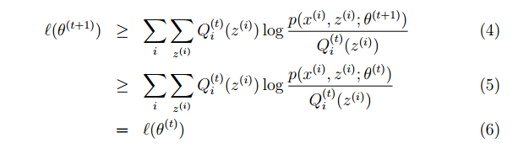

Prove this algorithm will converge
We will now prove that l(θ(t)) ≤ l (θ(t+1)), which shows EM always monotonically improves the log-likelihood. The key to showing this result lies in our choice of the $Q_{i}$’s.
Hence, EM causes the likelihood to converge monotonically. one reasonable convergence test would beto check if the increase in `(θ) between successive iterations is smaller than some tolerance parameter

Slide 9
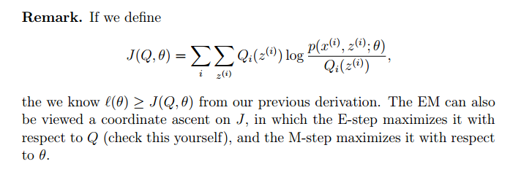

Slide 10
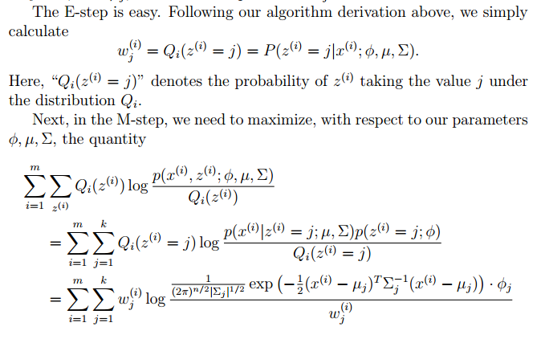
Mixture of Gaussians revisited

Slide 11
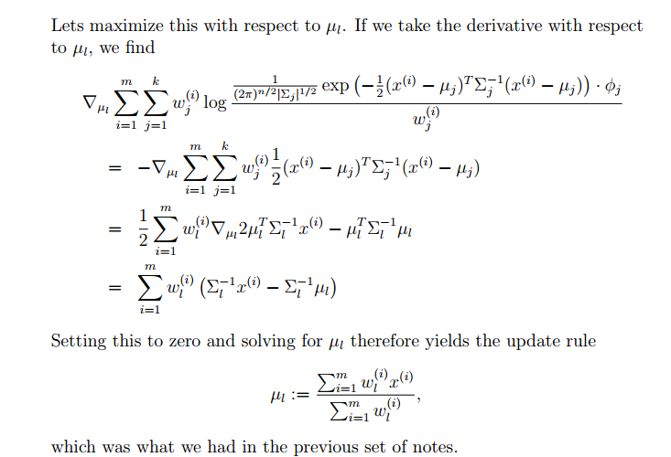

Slide 12
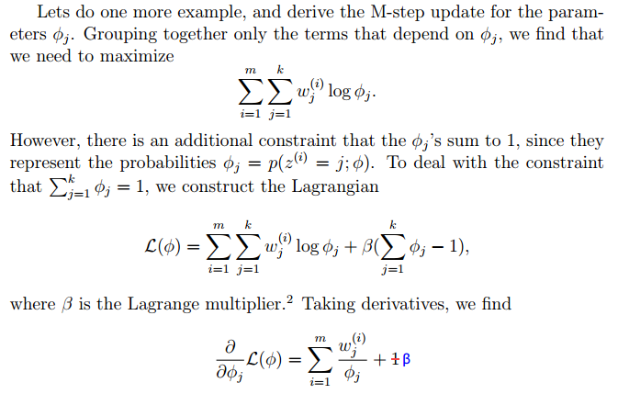

Slide 13
